Slide 1





Ігор Лиман
1 березня 2023
2

Slide 2
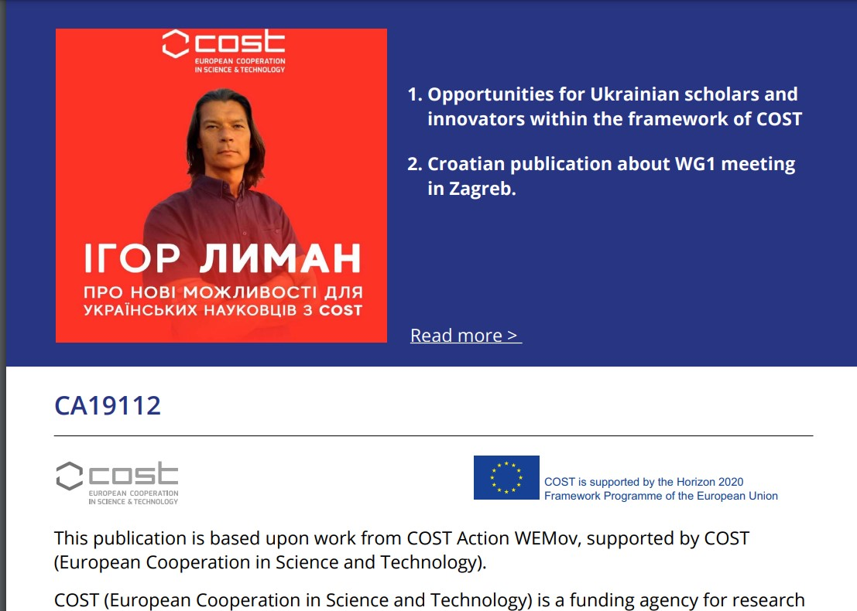

Slide 3


Slide 4

European Cooperation in Science & Technology
MISSION
STRATEGIC
COST provides networking
PRIORITIES
opportunities for researchers
and innovators in order to
strengthen Europe’s capacity
to address scientific,
Promoting and spreading
excellence
Fostering interdisciplinary research
technological and societal
VISION
for breakthrough science
challenges
Europe’s most
Empowering and retaining young researchers
empowering
research
programme
2

Slide 5

Chapter 1
About COST
& Strategic
Priorities
3

Slide 6

European Cooperation in Science & Technology
COST provides networking opportunities for researchers and innovators in order to strengthen
Europe's capacity to address scientific, technological and societal challenges
ALL FIELDS OF S&T
(mono- or interdisciplinary,
new and emerging fields)
ALL CAREER STAGES
(young and experienced researchers)
ALL PARTNERS
ALL COUNTRIES
(academia, public organisation, industry,
NGO, International Organisations)
•
40 COST Members
+ 1 Cooperating Member
14 Near Neighbour Countries
Global cooperation
•
•
BOTTOM-UP APPROACH
4

Slide 7

Role of COST in the ERA
3 STRATEGIC
PRIORITIES
1
3
2
Promoting and
Empowering and
spreading excellence
retaining young
researchers
Fostering
interdisciplinary research
for breakthrough science
5

Slide 8

Key figures
292
203
€134,500
Average annual budget
of a COST Action
Running Actions
Training schools
2,320
scientific missions
45,000
€
153
million
Short-term
Researchers involved
in COST Actions
COST budget
(in Horizon Europe for a 3-yearperiod)
6

Slide 9
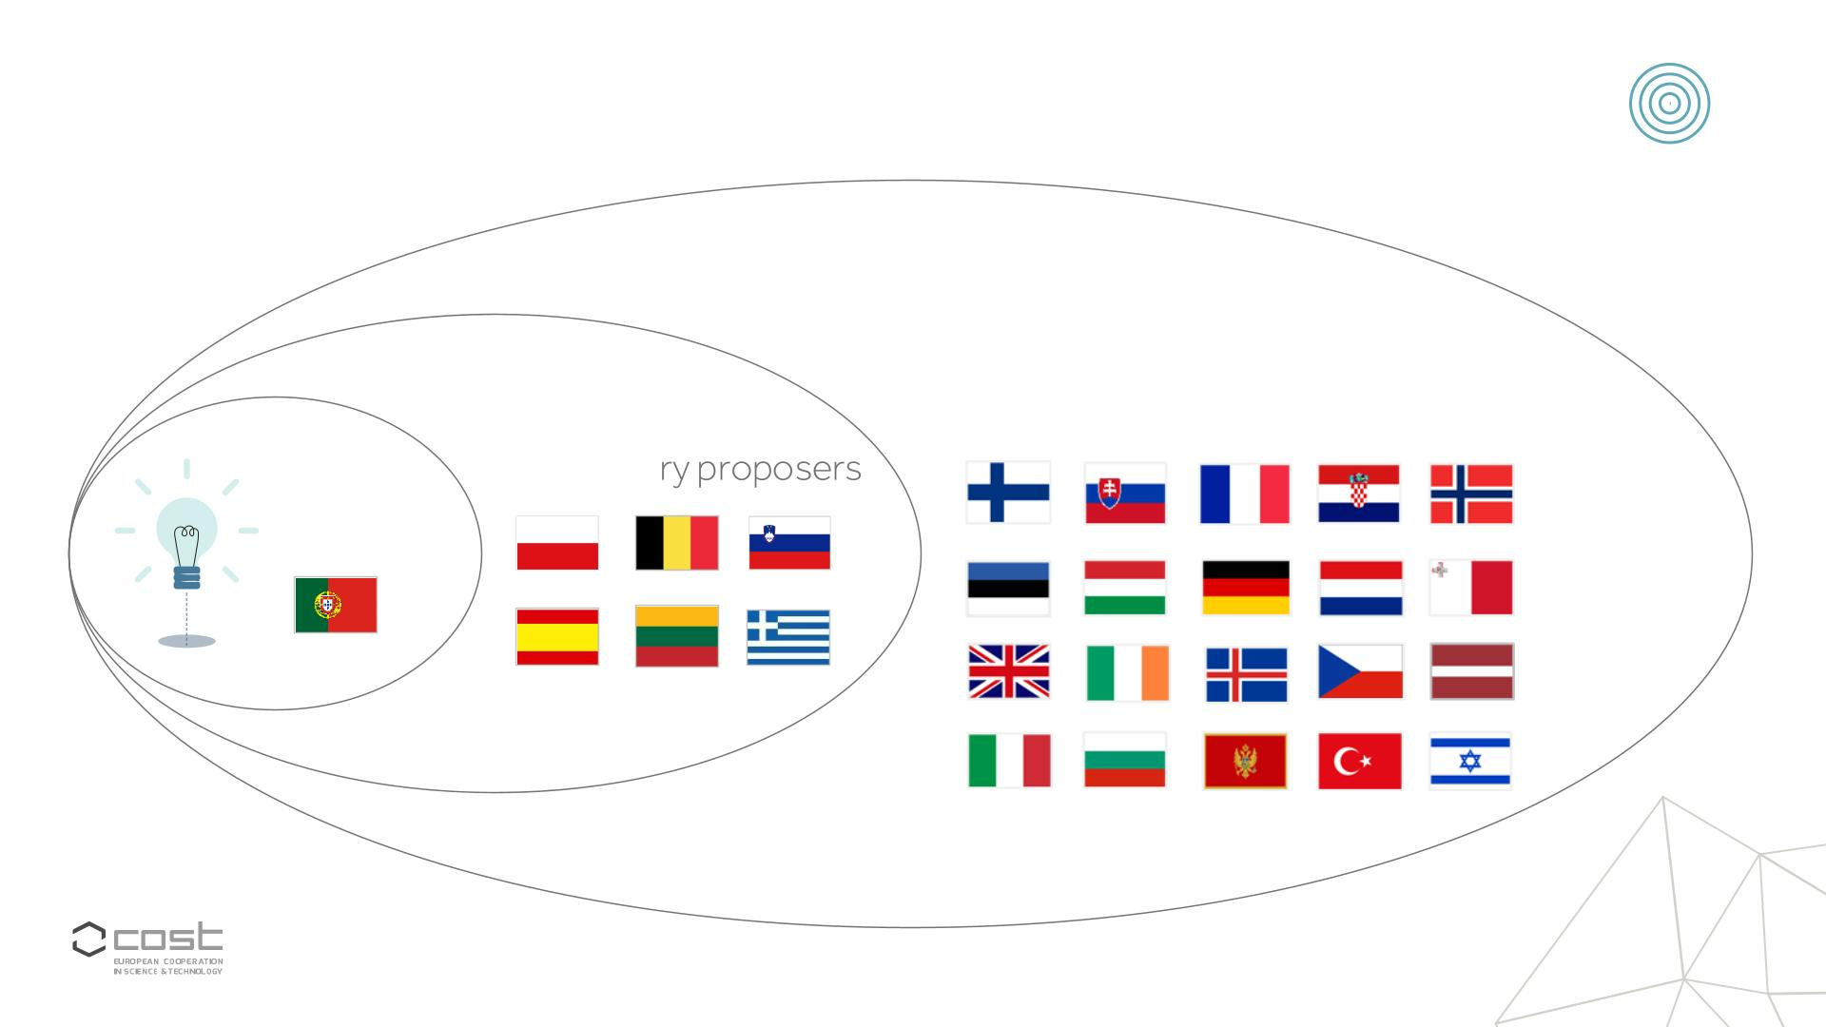
How it works?
Country representatives
nominated by
COST National Coordinators
Secondary proposers
Main
proposer
7

Slide 10
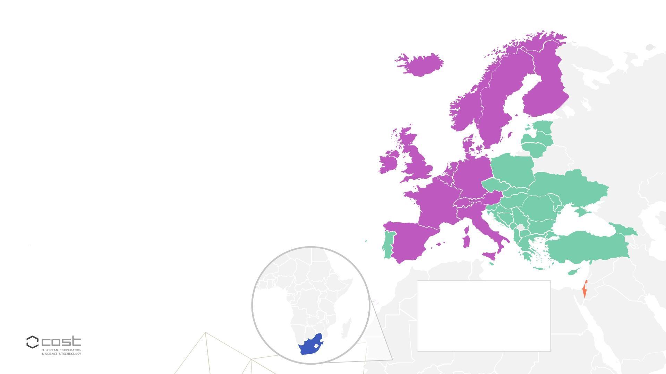
COST Membership
40 Members
 Albania
 Greece
 Norway
 Poland
 Austria
 Hungary
 Belgium
 Iceland
 Portugal
 Romania
 Serbia
 Bosnia and Herzegovina
 Bulgaria
 Ireland
 Italy
 Croatia
 Latvia
 Slovakia
 Slovenia
 Spain
 Cyprus
 Lithuania
 Czech Republic
 Denmark
 Estonia
 Luxembourg
 Malta
 Sweden
 Switzerland
 Turkey
 The Republicof Moldova
 Montenegro
 The Netherlands
 The Republicof
North Macedonia
 Finland
 France
 Ukraine
 United Kingdom
 Georgia
 Germany
1 Cooperating Member 1 Partner Member
 Israel
 South Africa
 COSTMembers non-ITCs
(Inclusiveness Target Countries)
 COSTMembers ITCs
 COSTCooperating Member
 COSTPartner Member
8

Slide 11

Dedicated measures for active ITC participation
COST Info Days
• Targeted to ITC
Proposals
• Eligibility
• Combinedwithhigh-level meetingITC
• External experts
• Inclusivenesspolicy
government,including CNC
COST Actions
• COST Action leadership
COST Academy
• Leadership workshop
• Finance/adminworkshop
• Science communication training
• Mentoringgrant holder
• Mentoringchair
• Conference grant for PhD students
and young researchers
• Pre-payment for STSM
9

Slide 12
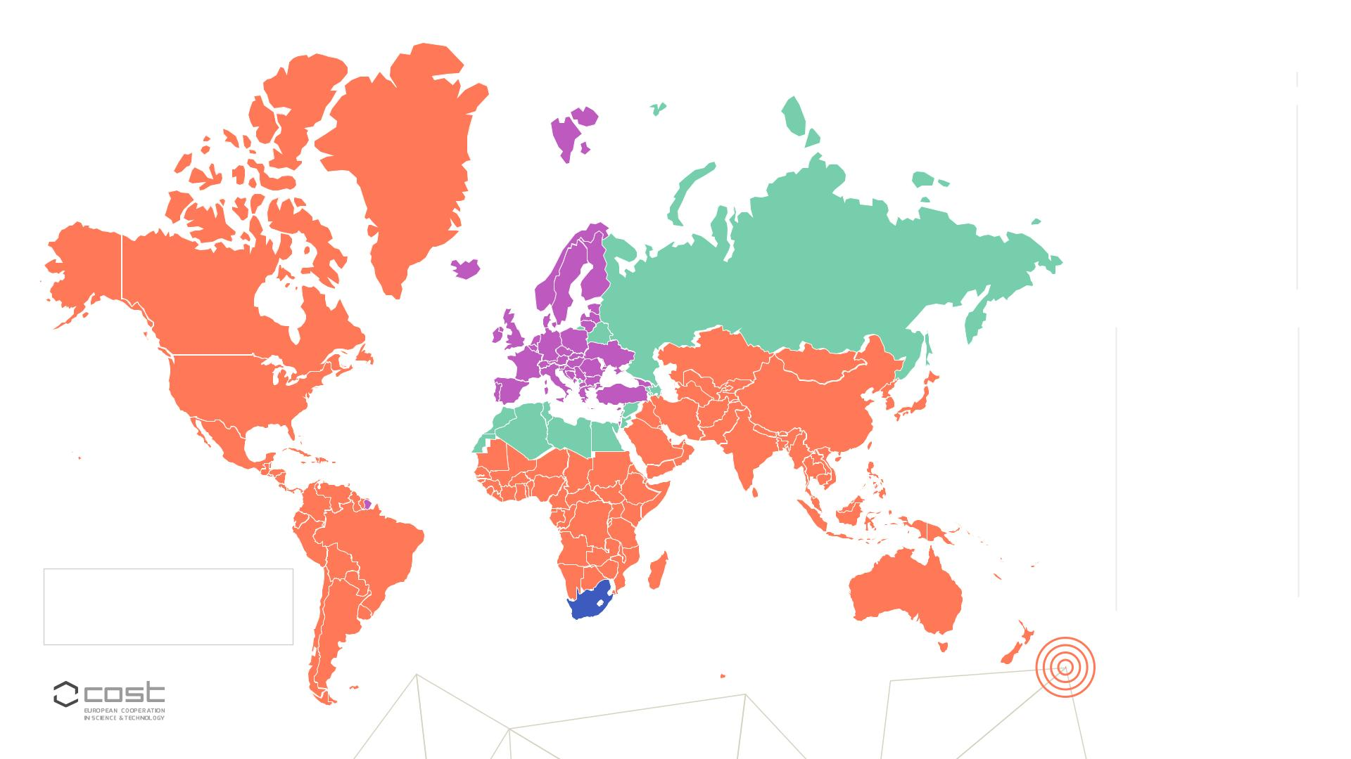
Priority 1

South Africa
34













Algeria
16
44
18
33
15
18
36
12
36
7
Armenia
PROMOTING AND SPREADING EXCELLENCE
Azerbaijan
Belarus
Egypt
Jordan
Kosovo*
Lebanon
Morocco
Palestine**
Russian Federation
Syrian Arab Republic
Tunisia
91
1
55




















Argentina
Australia
Bangladesh
Brazil
14
69
1



















Malaysia
2
1
Nepal
New Zealand
Nigeria
13
3
Canada
Chile
40
63
12
30
11
5
Pakistan
2
China
Peru
2
Colombia
Costa Rica
Cuba
Republic of Rwanda
Saudi Arabia
Senegal
1
2
1
Singapore
South Korea
Taiwan
1
Ecuador
Ethiopia
Hong Kong SAR
India
3
10
7
1
Uganda
2
2
United Arab Emirates
United States
Uruguay
1
Iran
13
8
4
Japan
47
2
211
2
Kazakhstan
Kenya
Uzbekistan
Venezuela
Vietnam
1




COST Members
COST Partner Member
COST Near NeighbourCountries
Third States/International Partner Countries
Kuwait
2
1
Mexico
1
2
11
12

Slide 13
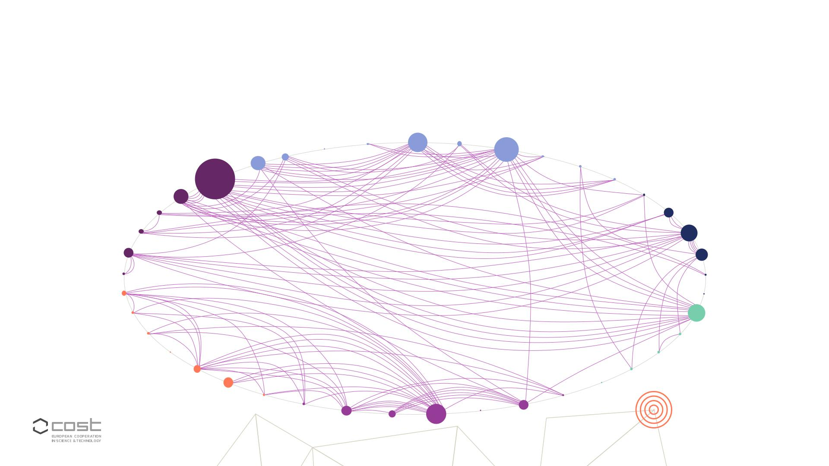
Priority 2
FOSTERING INTERDISCIPLINARY RESEARCH FOR BREAKTHROUGH SCIENCE
Materials
Environmental
Mechanical
Chemical engineering
Medical
engineering engineering
Environmental
biotechnology
Industrial biotechnology
Electrical and information
engineering
engineering
engineering
Civil engineering
Biological sciences
Earth and environmental sciences
Nanotechnology
Other engineering and technologies
Chemical sciences
Basicmedicine
Clinical medicine
Physical sciences
Computer and information
Health sciences
sciences
Mathematics
Medical biotechnology
Other humanities
Arts
Other medical sciences
Agriculture, forestry
and fisheries
Philosophy,ethics and religion
Languages and literature
Animal and dairy science
Veterinary science
Agricultural biotechnology
Other agricultural sciences
Psychology
Economics and business
History and archeology
Other social sciences
Mediaand communications
Social and economic
geography
Political
science
Law
Educational
Sociology sciences
13

Slide 14

Priority 3
EMPOWERING AND RETAINING YOUNG RESEARCHERS
Researchers’ career development and
ERC Advanced
Grant
complementary funding schemes
E R C Consolidator
Grant
ERC Starting
Grant
MSCA
Assistant
professor/
Full professor
Full professor
Erasmus+
Students
Assistant
professor/
Associate
professor
Post-docs
Post-
graduates
BOTTOM-UP NETWORKING
SCHEMES
15

Slide 15
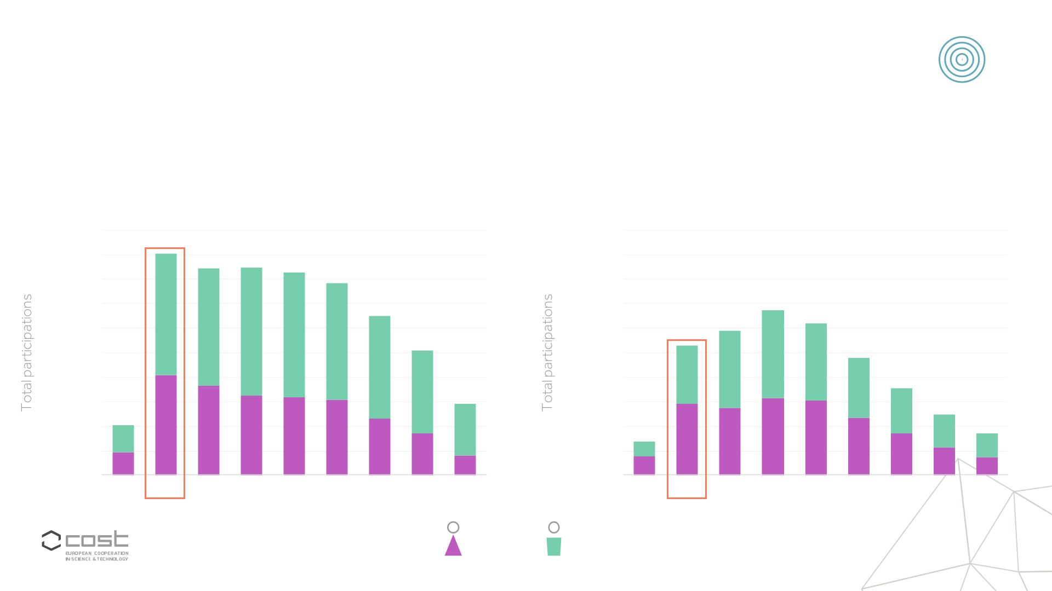
Priority 3
EMPOWERING AND RETAINING YOUNG RESEARCHERS
Data from Horizon 2020 (2014-2021)
Other Countries
Inclusiveness Target Countries
20,000
18,000
16,000
14,000
12,000
10,000
8,000
6,000
4,000
2,000
0
20,000
18,000
16,000
14,000
12,000
10,000
8,000
6,000
4,000
2,000
0
21-25 26-30 31-35 36-40 41-45 46-50 51-55 56-60 61-65
21-25 26-30 31-35 36-40 41-45 46-50 51-55 56-60 61-65
Female
Male
17

Slide 16
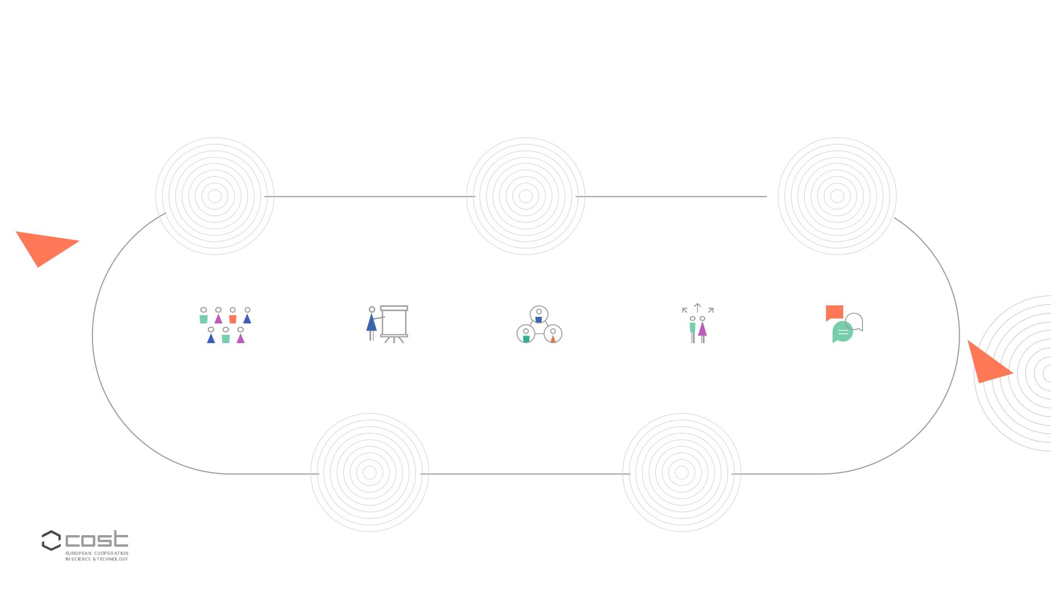
Implementing COST’s strategic priorities
COST
COST
COST
Innovators
Academy
science-informed
Grant
policy advice
COST ACTIONS
Meetings, workshops
conferences,
and conference
grants
Training
schools
Short-term
Dissemination
activities
Virtual networking
grants
scientific missions
COST
Connect
COST global
networking
18

Slide 17

COST in Horizon Europe
Horizon Europe =
COST activities
COST Actions
receive budget under
Third Party Funding
Wideningparticipation
and strengthening the
EuropeanResearch
Area pillar
are implementedby the
COST Association,undera
Framework Partnership
Agreement and Specific
Grant Agreements with
the EuropeanCommission
21

Slide 18

Benefits of participating
in a COST Action
Scientific
Financial
support
Networking
Career
opportunities
24

Slide 19

The value of networking
60 Actions
Participation in COST Actions
end every year
(on average)
Follow-up proposals have a
success rate of more than 37%
COST
programme
€5.8 million spin-off
funding per Action
(on average)
€2.6 billion across
Horizon 2020
25

Slide 20

COST Actions
An efficient
networking
tool
26

Slide 21

COST Actions
AN EFFICIENT NETWORKING TOOL
Memorandum
of Understanding
COST provides funding
for research coordination
and capacity building
activities
4 years
Min 7 countries, average
participation 30 countries
COST is not funding
research itself,
but pooling resources
Network
and research results
by networking
Research coordination
and capacity building activities
~ €600,000 over lifetime
27

Slide 22
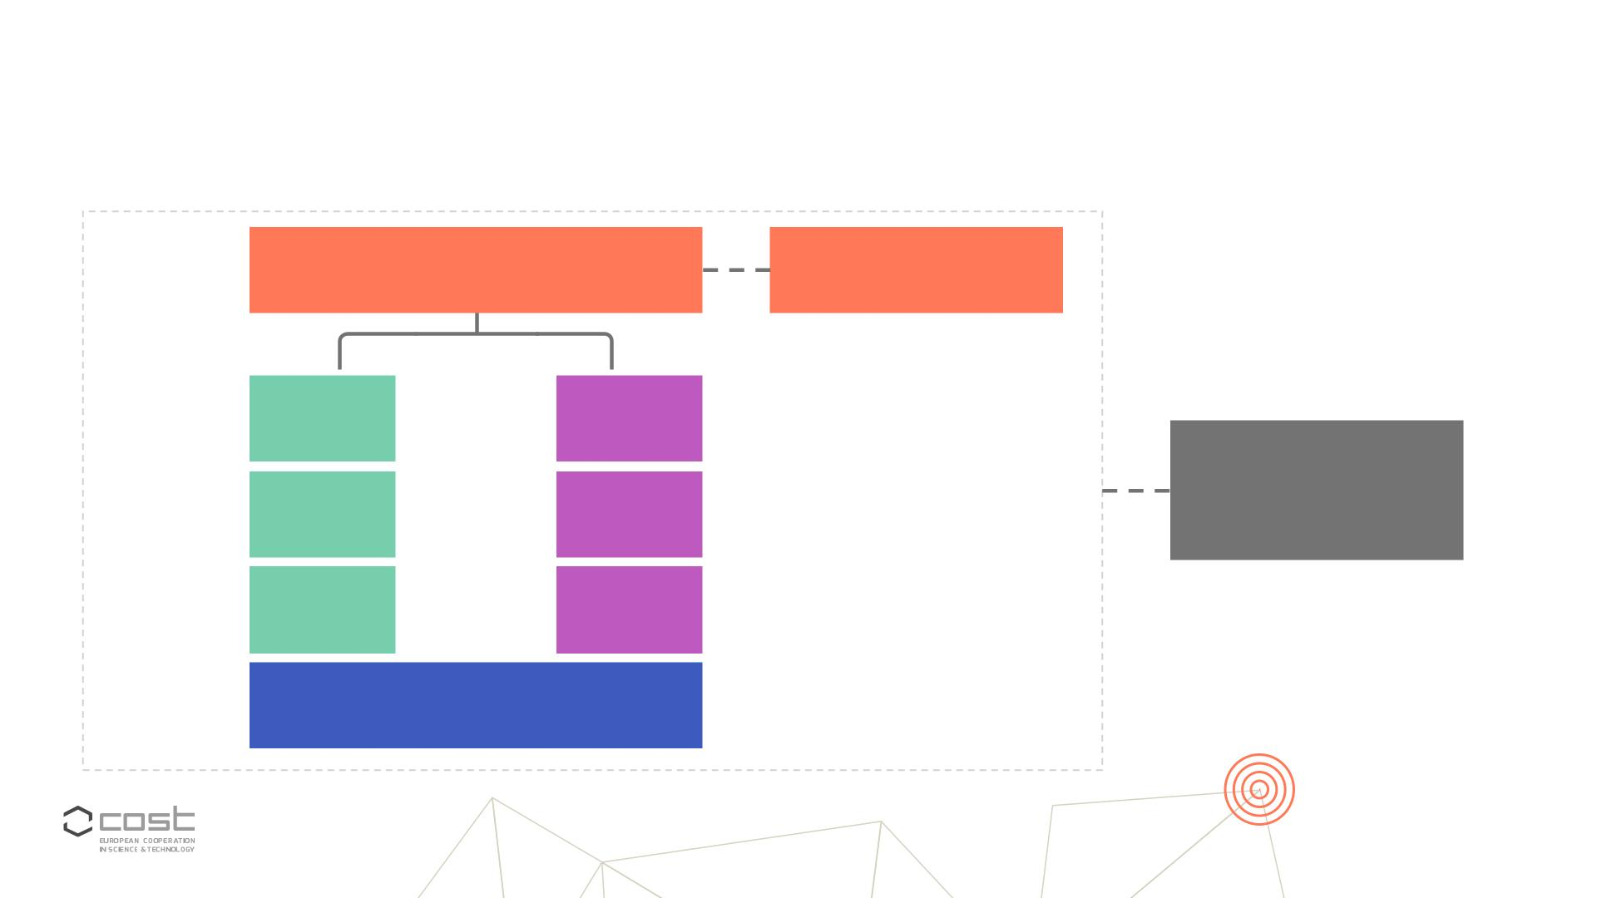
LEADERSHIP POSITIONS
Action Chair
MANAGEMENT COMMITTEE (MC)
GRANT HOLDER (GH)
Vice-Chair
GH scientific rep.
WG1
WG2
WG3
WG4
WG5
WG6
COST
ASSOCIATION
ADMINISTRATION
WG leaders
HORIZONTAL GROUPS
Grant Awarding Coordinator
Science Comm. Coordinator
28

Slide 23

MC & Core Group
Meetings
Working Group
Meetings
Training
Schools
Workshops &
ITC Conference Grants
Conferences
Networking
for Young Researchers
Activities &
Other Expenses
Other
Short-Term Scientific
Expenses
Missions
(LOS, OERSA)
Dissemination
Conference Grant
Dissemination &
Communication
Products
Virtual Networking
Grants
29

Slide 24

Reimbursement
LOCAL ORGANISER SUPPORT (LOS)
1
GRANT
Calculatedbased on
Type of event
Total unique participants
Signature of the attendance
list/ presence on the virtual
attendance log
Face to face
Virtual
Hybrid
Duration of event
37

Slide 25

How to engage with COST?
1
3
2
As a participant
of a running Action
As expert to evaluate
submitted proposals
As a proposer
of a new COST Action
44

Slide 26

1. As a participant in a running Action (2/2)
AS A MANAGEMENT COMMITTEE (MC) MEMBER
(contact the COST National Coordinator)
AS A WORKING GROUP (WG) PARTICIPANT
(contact the WG leader)
AS A PARTICIPANT IN ACTION ACTIVITIES
short-term scientific mission, ITC conference grant, training school,
workshop/conference,…
(check the Action’s website, contact the chair or the national MC member)
46

Slide 27

2. As proposer of a new COST Action
COST OPEN CALL
One-stage online
submission of
Proposal should focus on
S&T Excellence, Networking
Excellence, Impact and
Implementation
70 COST Actions
approved per collection
proposals (e-COST)
Main proposer +
Collection date:
20 October 2022
12:00 CET
www.COST.eu
secondary proposer
opencall@cost.eu
47

Slide 28

Proposals
GENERAL
FEATURES
NETWORK OF
PROPOSERS
TECHNICAL
ANNEX
(www.cost.eu)
COST EXCELLENCE AND
1. S&T Excellence
2. Networking Excellence
3. Impact
INCLUSIVENESS POLICY
SPECIFIC OBJECTIVES
4. Implementation
49

Slide 29


Slide 30

THANK YOU!

